Slide 1
Investigating the effect of side chain packing on membrane protein association

Slide 2
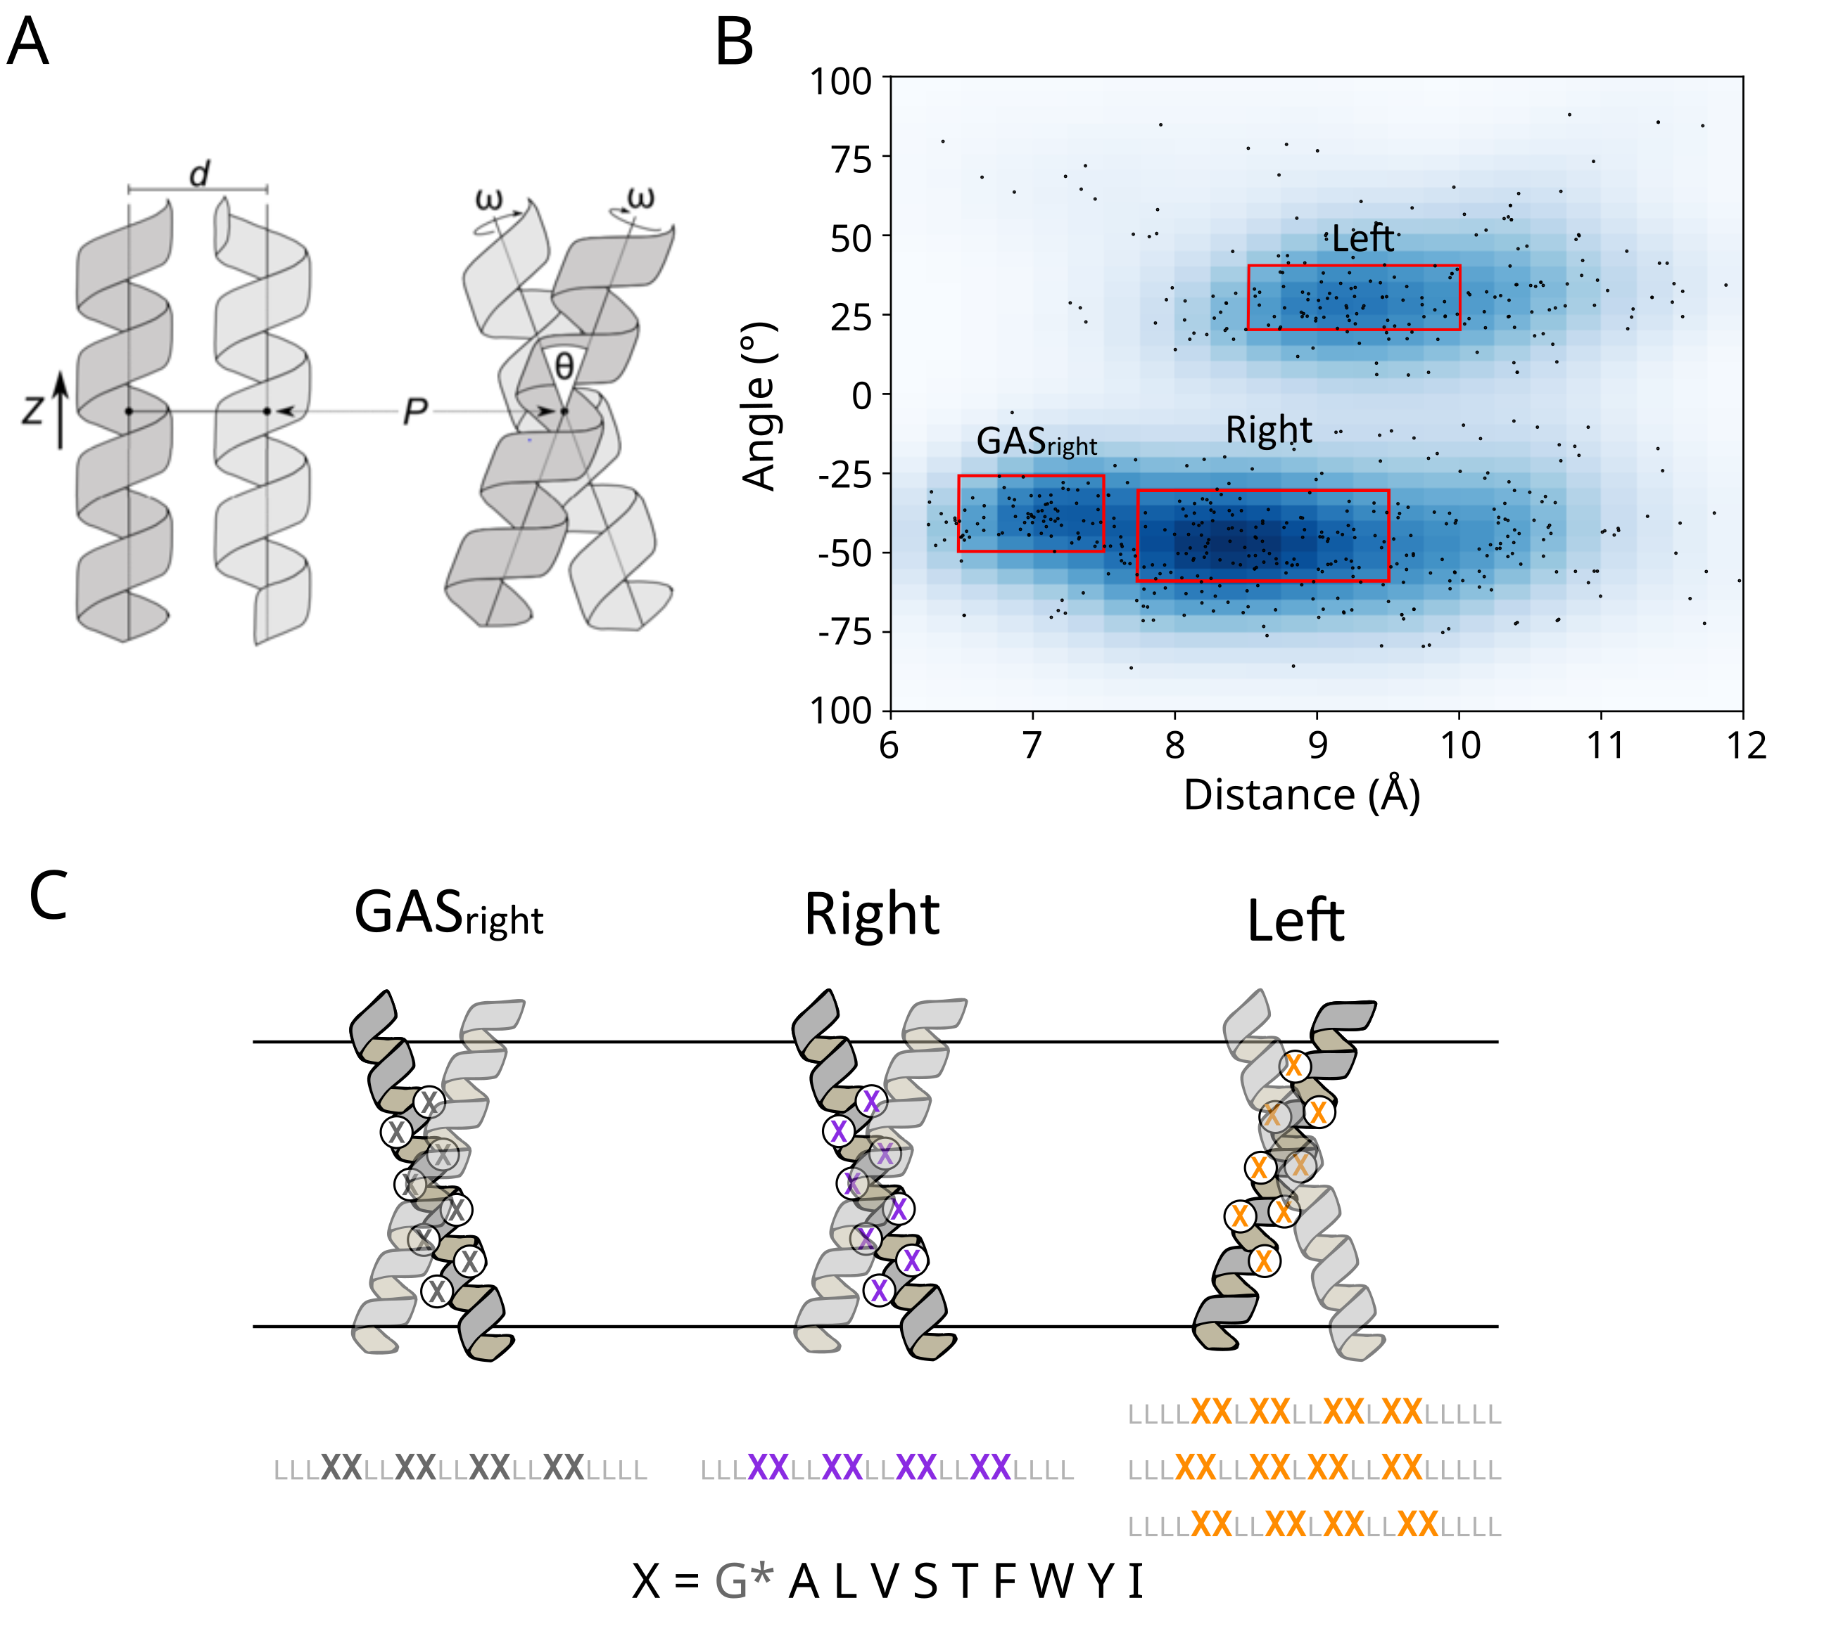
Membrane Protein Design

Slide 3
Extracted non-redundant helices from OPM

Slide 4
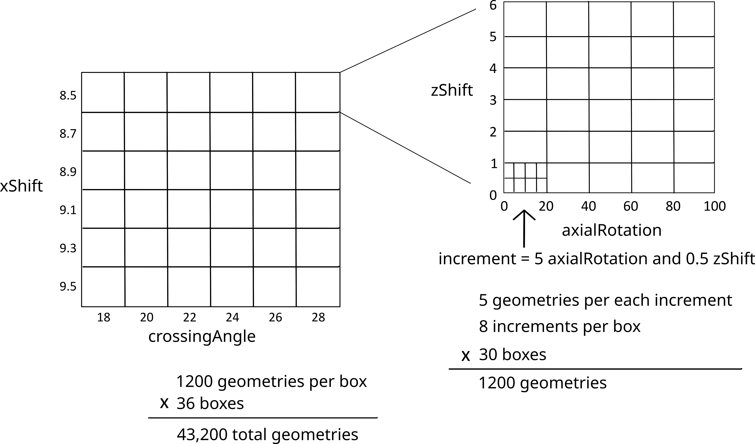
Defined axial rotation and z-shift through geometry testing

Slide 5
Defined axial rotation and z-shift through geometry testing

Slide 6
Interfaces defined for each region

Slide 7
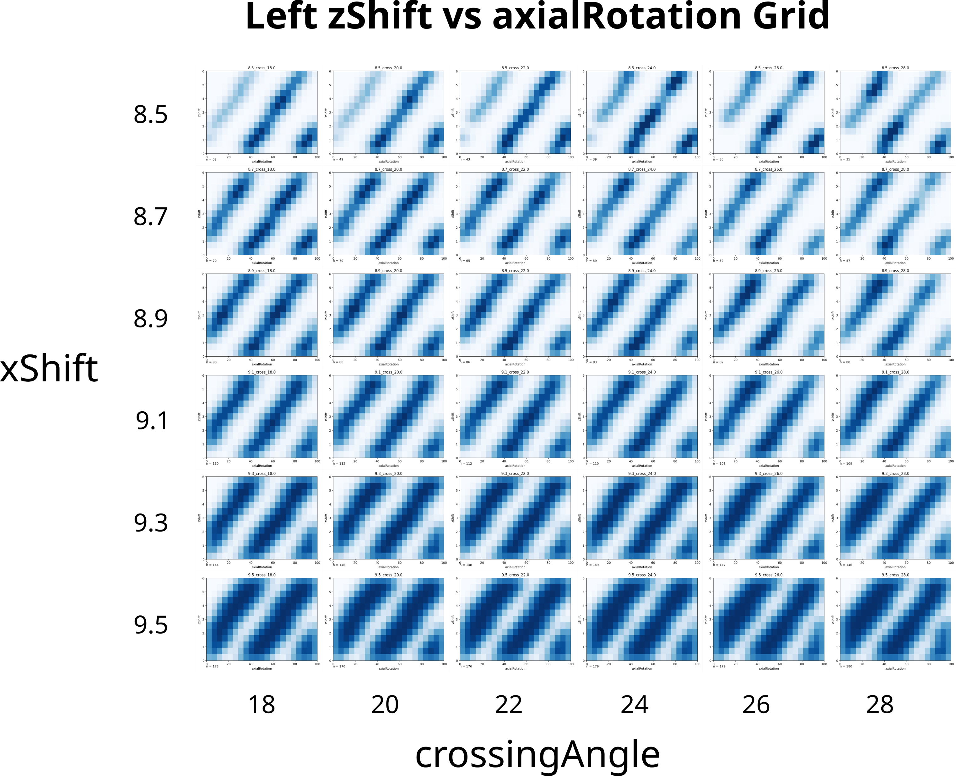
Left interface depends on axial rotation and z-shift

Slide 8
Subset of AAs chosen for design

Slide 9
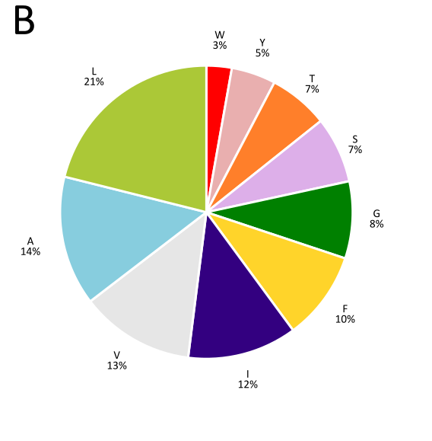
AA Composition of OPM helices

Slide 10
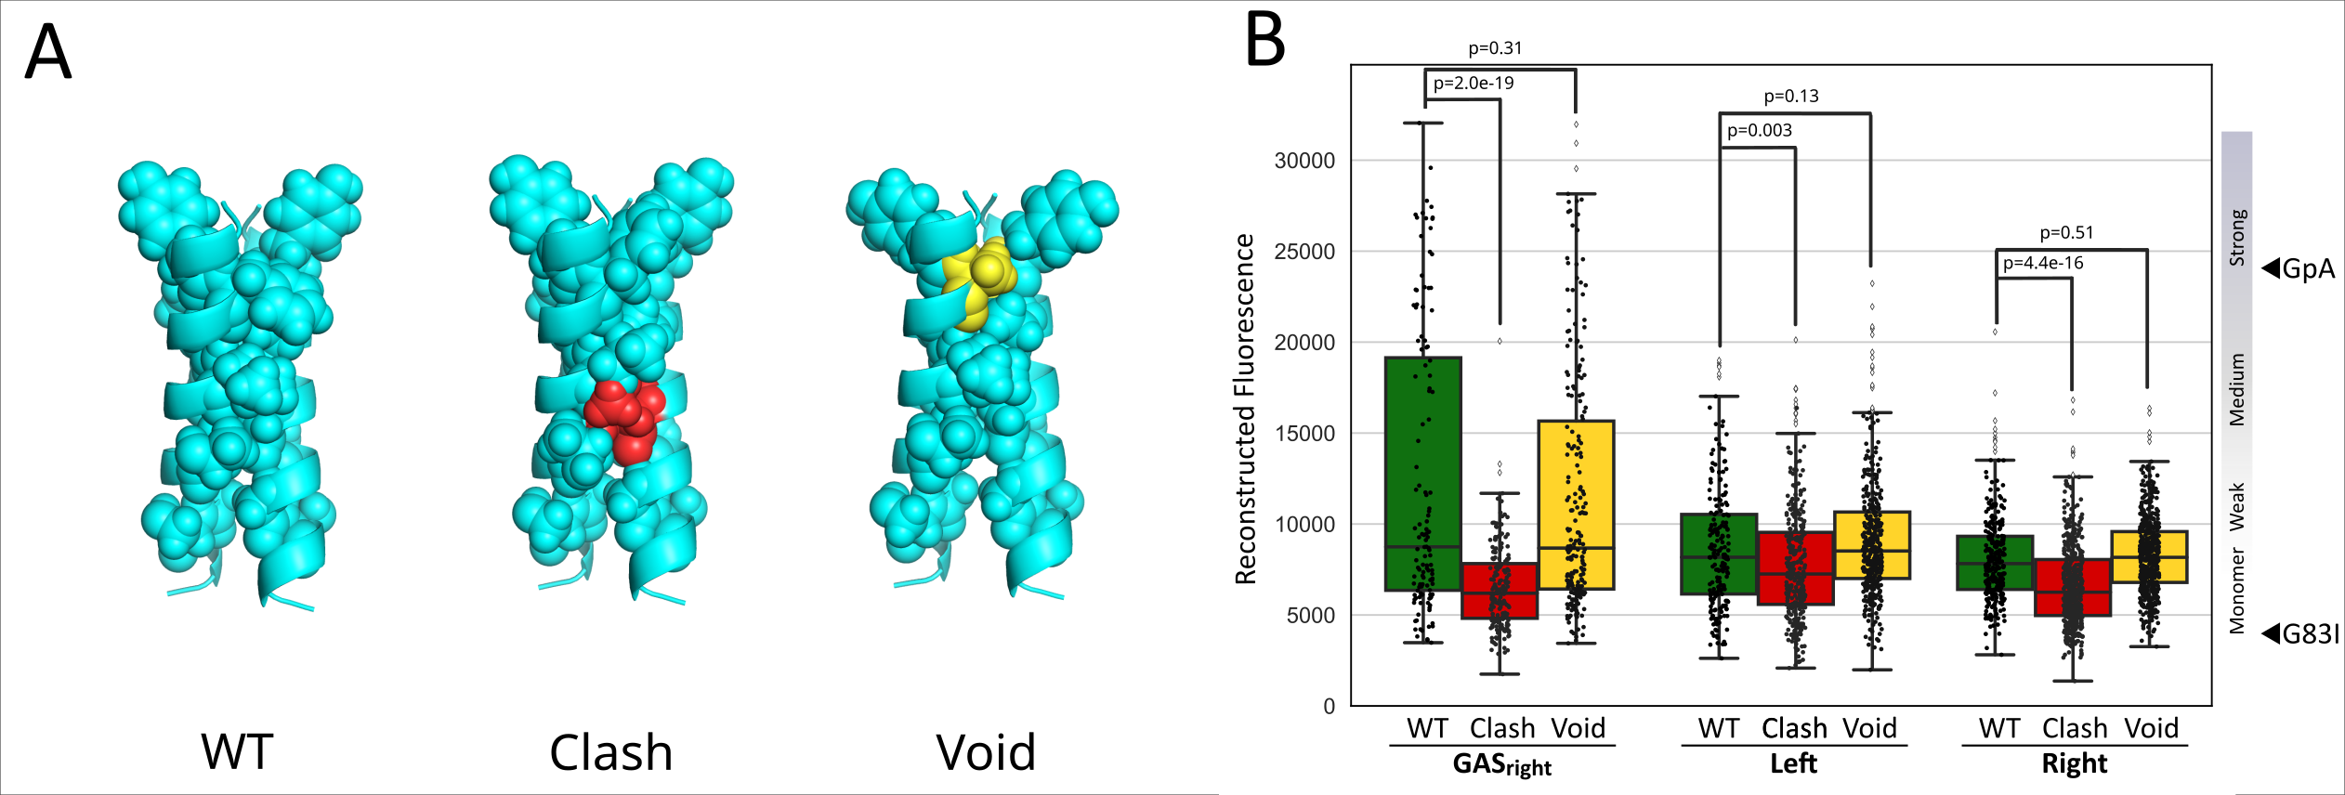
Types of mutations

Slide 11
GASright displays higher association

Slide 12
Clash mutants display significantly less association

Slide 13
Void mutants associate similar to WT

Slide 14
Void mutants associate similar to WT
< 35% GpA

Slide 15
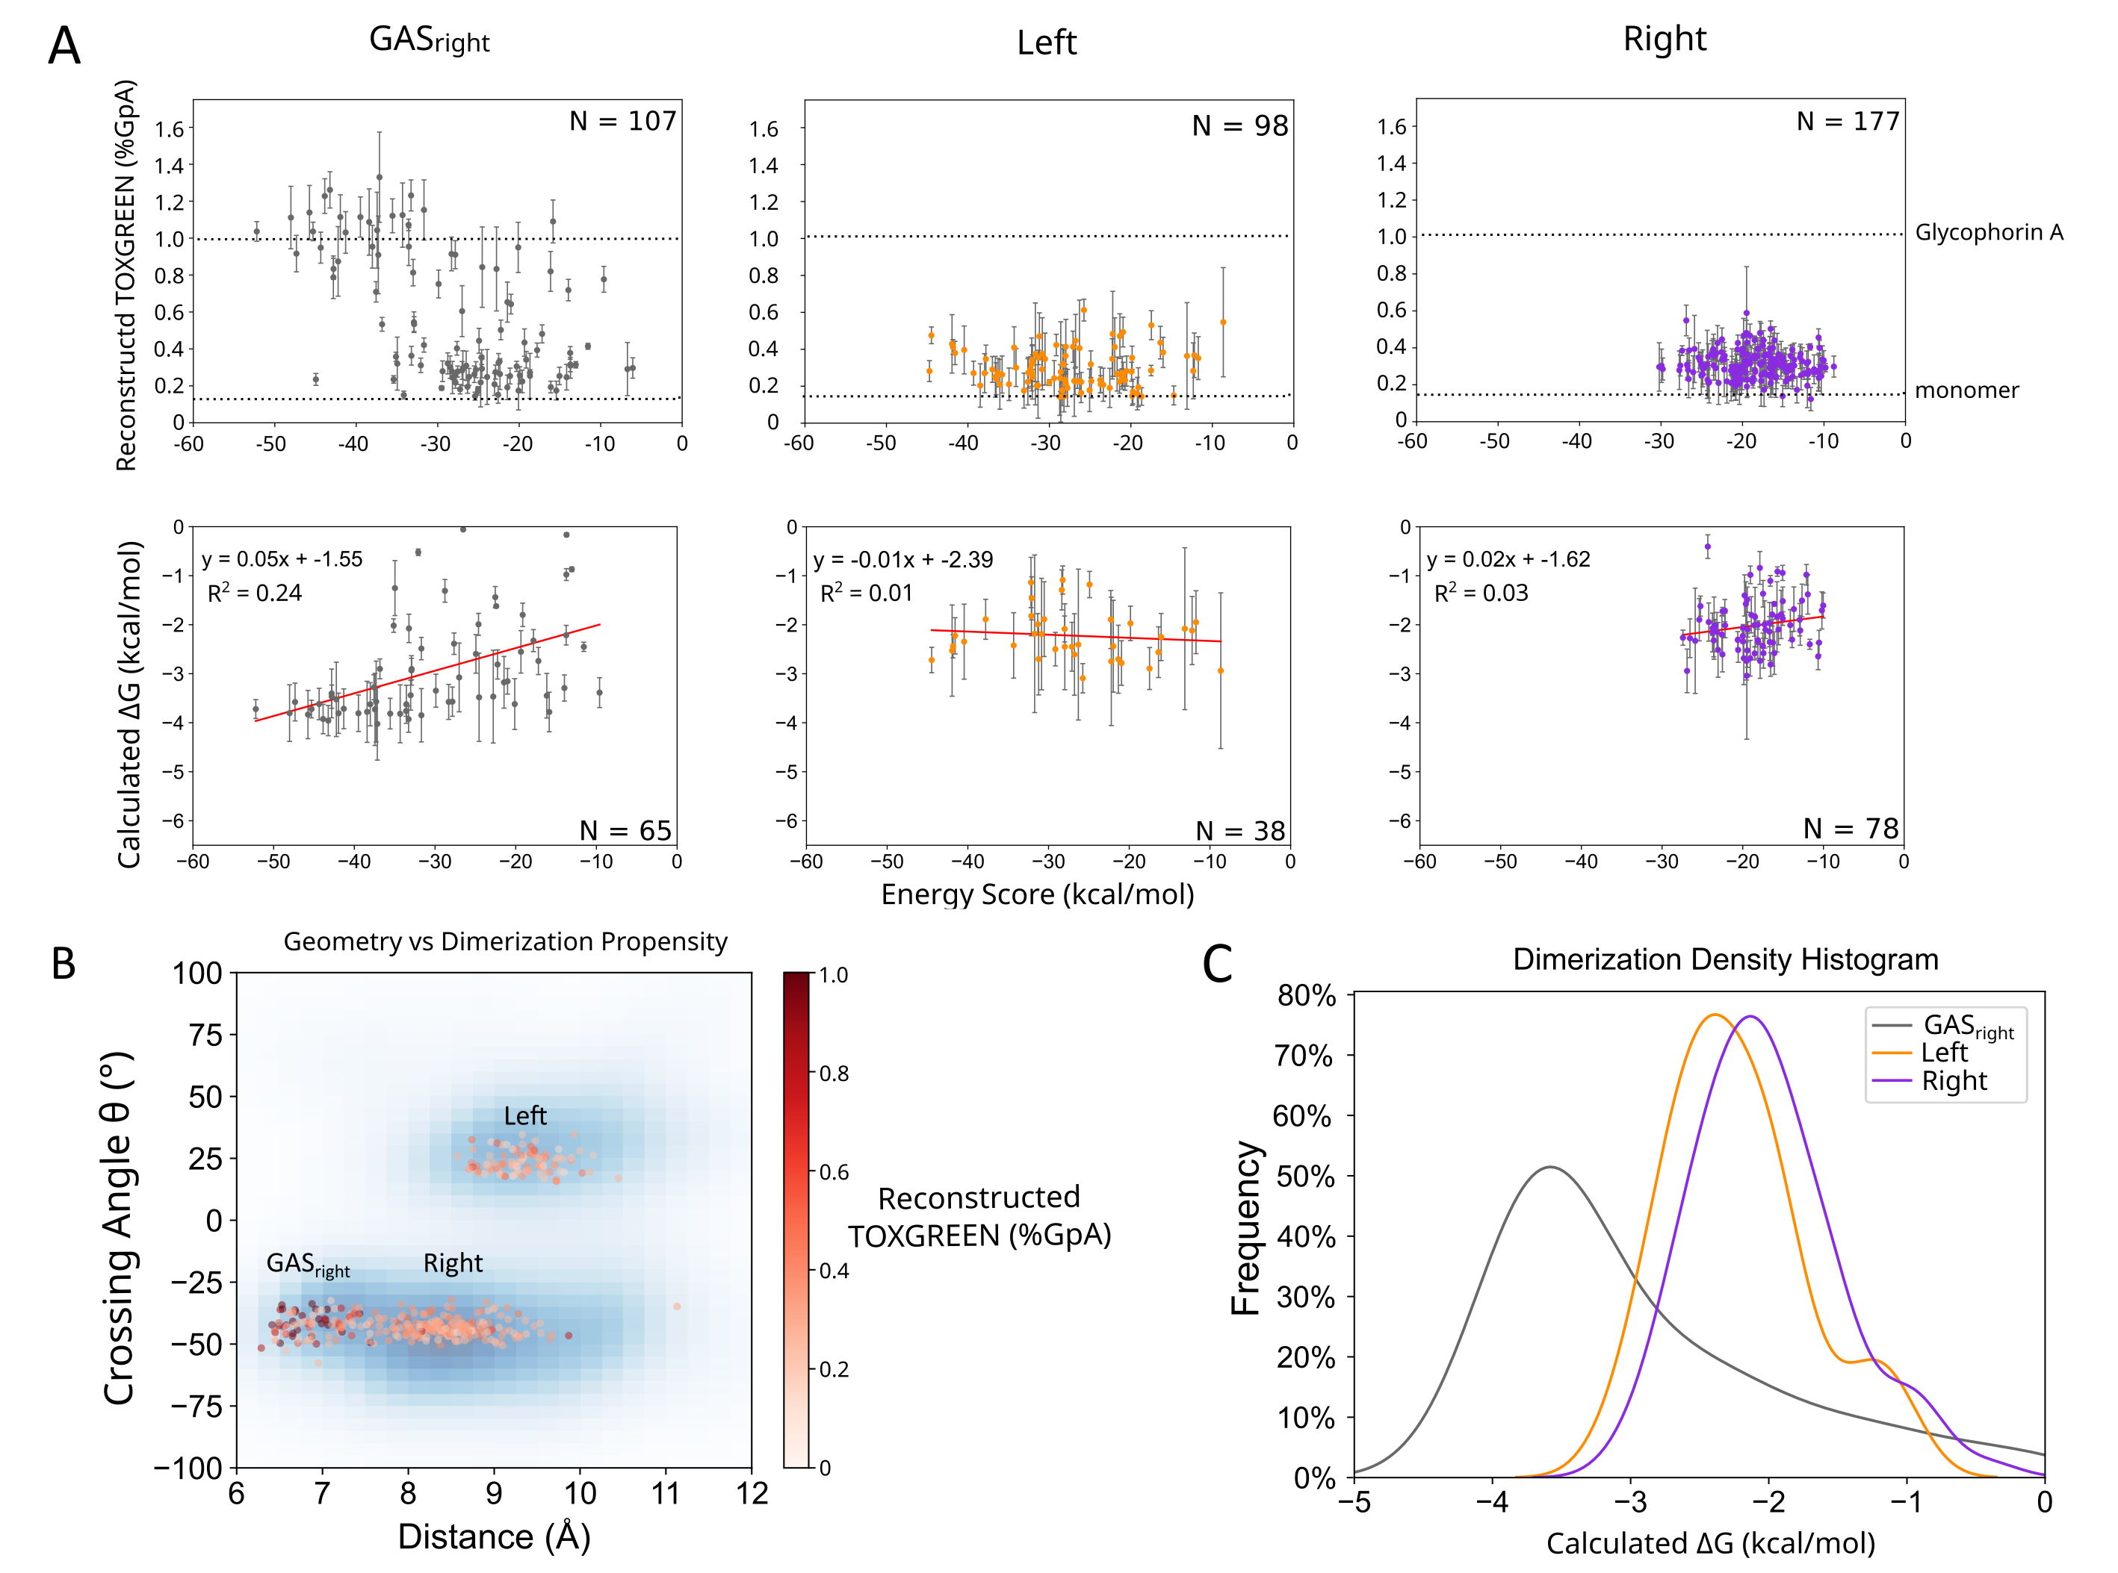
GASright shows better correlation with energy score

Slide 16
GASright shows better correlation with energy score

Slide 17
GASright shows better correlation with energy score

Slide 18
GASright shows better correlation with energy score

Slide 19
Conclusions
Designed GASrights display higher association than sequences designed with VDW
Energy score cannot capture differences in association in the lower association range (near monomer)
Suggests that VDW alone is a weak driving force for membrane protein association

